Slide 1
Lorann game – Java Project
Presented by Origo Patrick-Ivann ,Bourthoumieux Thomas, Begue Mathieu , Chambefort Hugo
Notes:
Hello, we will introduce you our java project
We worked for 15 days on the creation of an existing game named LoraanGame
We had to implement an MVC pattern and connect the game to a database for the map managing

Slide 2
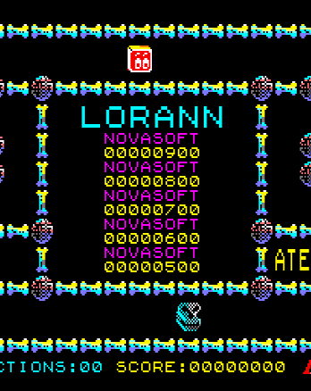
Plan : 1. Distribution of roles 2. Project management a)OBS b) GANTT c) PERT 3. MVC 4. Diagrams Example a) Package b) Class 6. Database part

Slide 3
Distribution of roles
BOURTHOUMIEUX Thomas : Leader
ORIGO Patrick-Ivann: Developer
BEGUE Mathieu:
Developer
CHAMBEFORT Hugo:
Developer

Slide 4
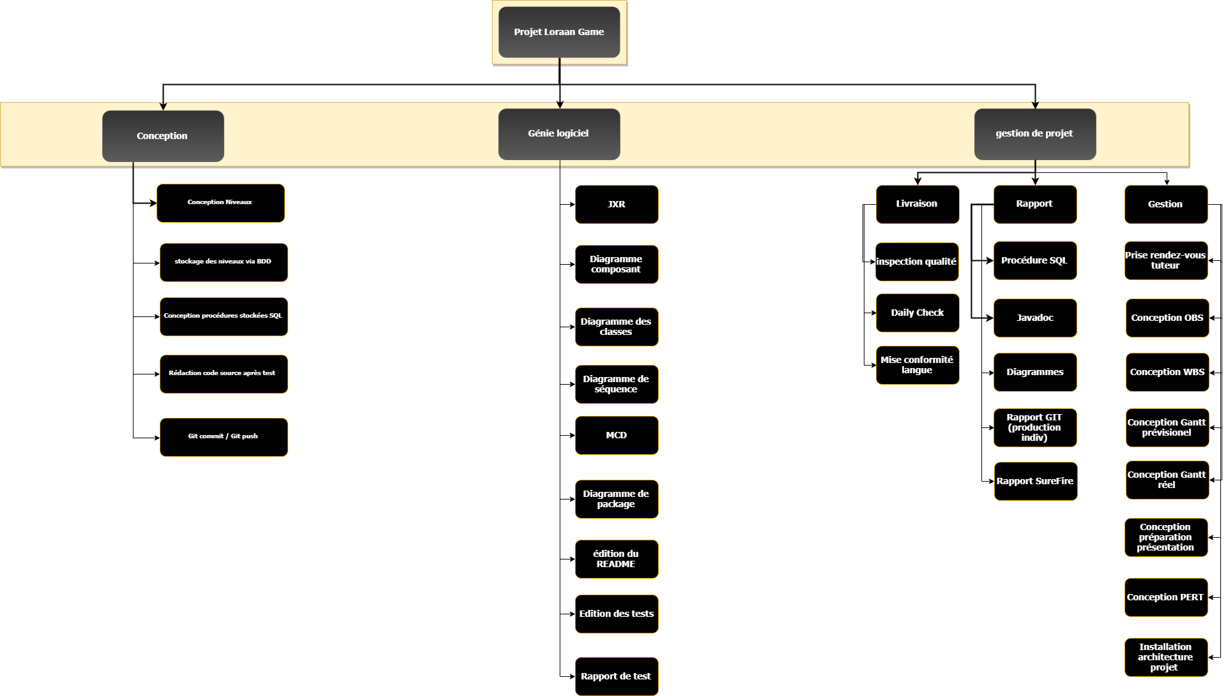
WBS

Slide 5
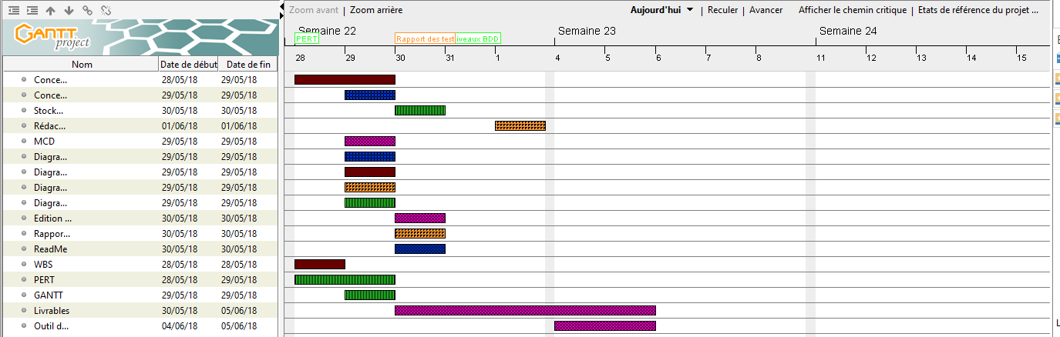
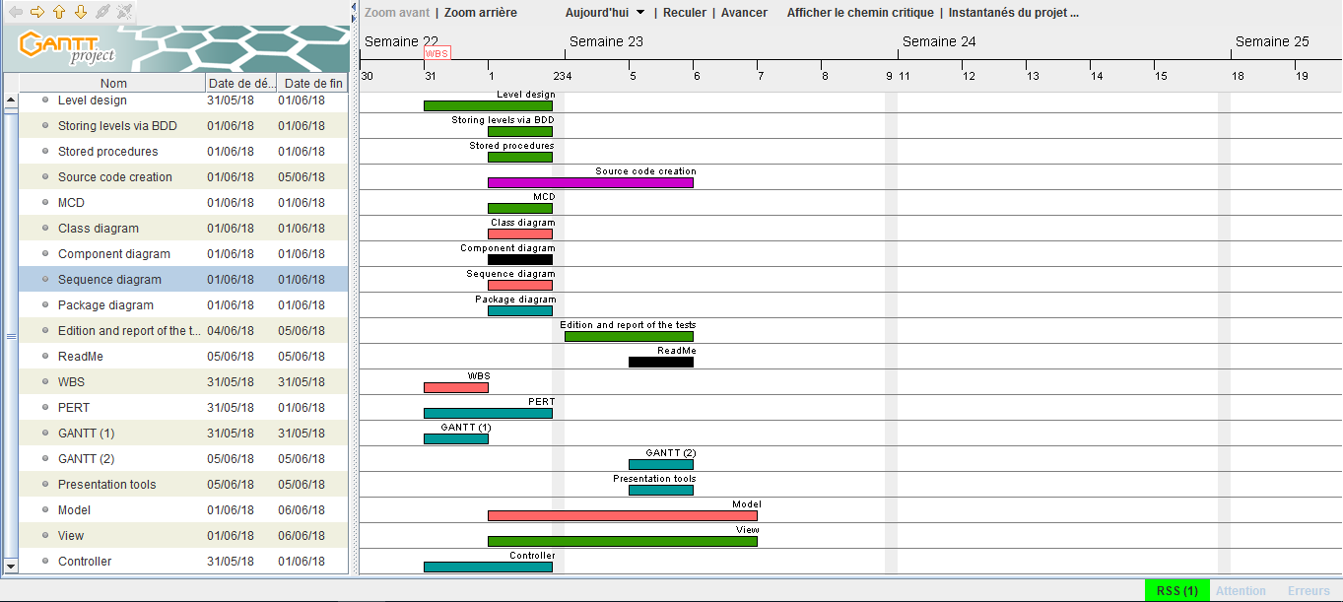
Project Management
1
2
Notes:
During this project, we used various project management tools to assign roles and tasks efficiently.
So we did a provisional Gantt and a real Gantt. This comparison allows us to see the tasks that witch are misjudged
As for example the view here that was the most complicated part and longer than expected
Each color corresponds to a member of the group which allowed us to
see if all the members of the group had tasks to do

Slide 6
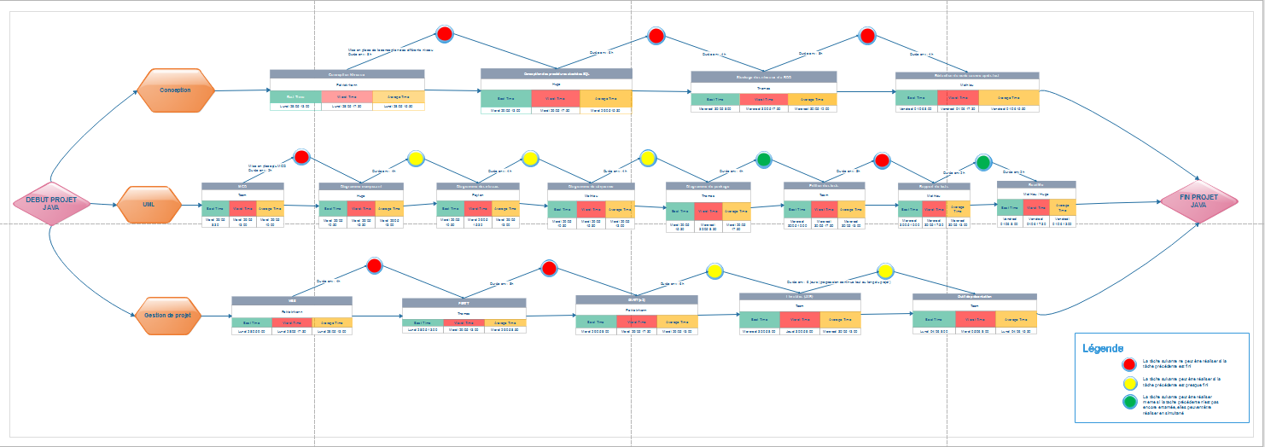
Pert
Notes:
The second project tool we used is the pert diagram. A good realization of it allowed us to
see the tasks that are important to perform.
We followed the division into 3 parts of the WBS as Peyton said for a better understanding of the 3 main axes
Some tasks are important to carry out
because one can not proceed to the next task without their realization (red dot).

Slide 7
MVC
Sends a user request
Controller
Return to user
Request processing
View
Model
Sent as part of the request
Sent to be
presented to user
Notes:
CONTROLLER : The controller contains the logic concerning the actions performed by the user
he module the processes user actions, modifies model and view data.
it triggers the method of the model and places the object list of the model to the view.

Slide 8
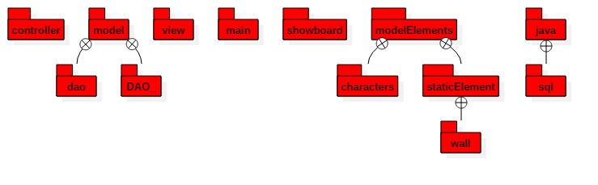
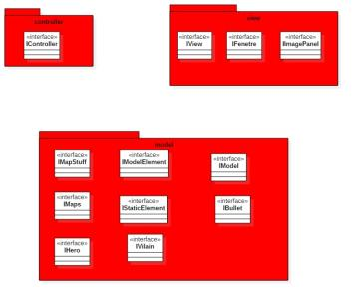
Package diagram
Contract package diagram

Slide 9

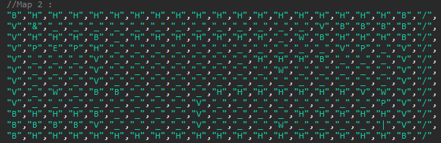
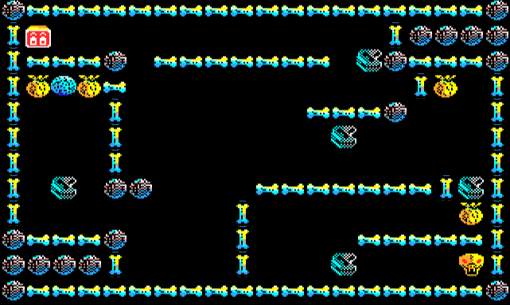
Database part

Slide 10
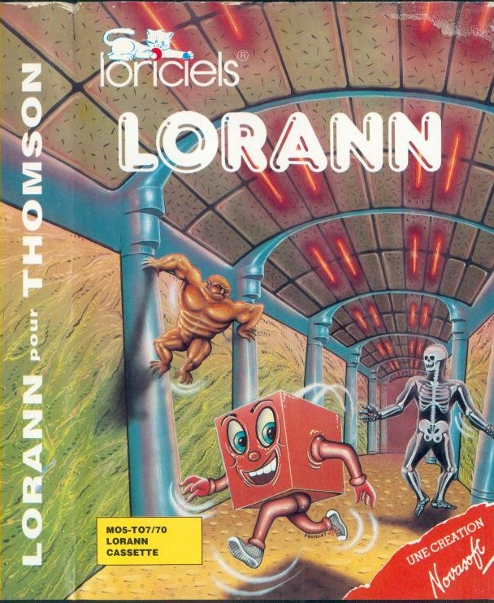
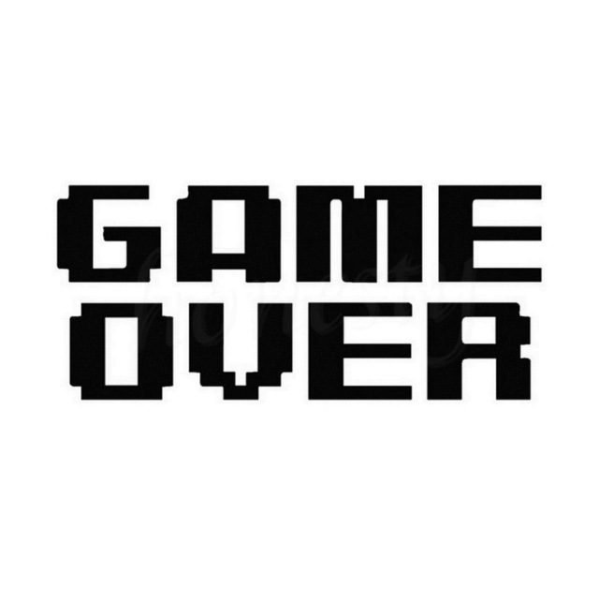
Thank you for
your attention

